Slide 1


Introduction to Service Oriented Architecture
Jay Ashbaugh

Slide 2

Agenda
Overview Service Oriented Architecture (SOA)
Reference Architectures
Enterprise Service Bus (ESB)
Messaging
Web API vs. Web Service
SOA Governance
Vendors

Slide 3

What does SOA mean to you?
The same thing we do every night, Pinky - try to take over the world!
Gee, Brain, what do you want to do tonight?
http://looneytunes.wikia.com/wiki/Pinky_and_The_Brain_%28characters%29
http://en.wikiquote.org/wiki/Pinky_and_the_Brain

Slide 4
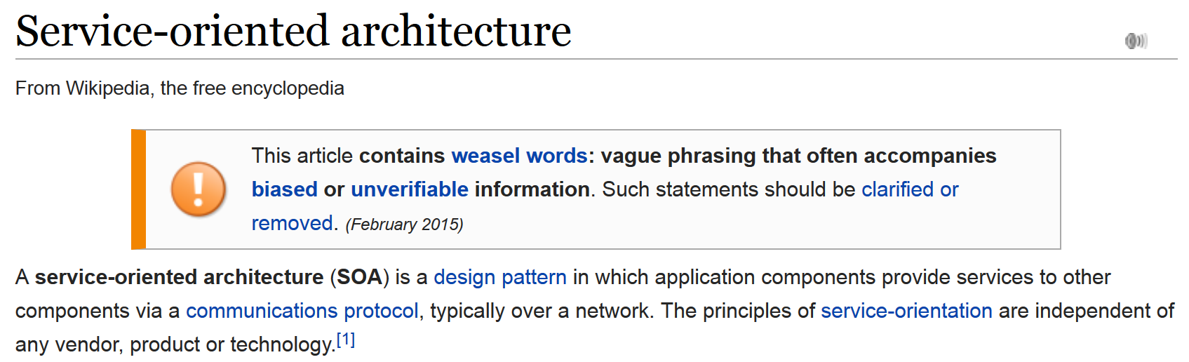
Overview SOA
http://en.wikipedia.org/wiki/Service-oriented_architecture

Slide 5

Overview SOA
CIO – “Journey”
Product Owner – “Services”
EA - Application Integration
Dev Manager - Highly Configurable
App Arch - Loosely Coupled
Dev - Contract Based Development

Slide 6
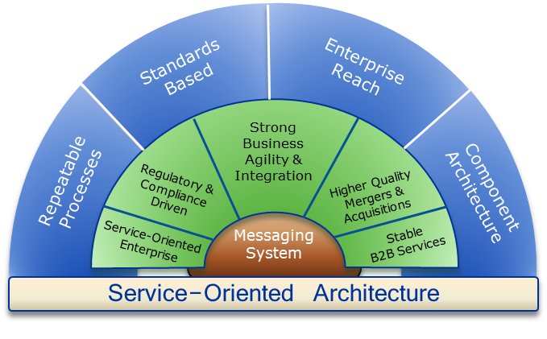
Overview SOA

Slide 7
Overview SOA
The What
Strategic | Business Functional | Architectural | Operational | Enterprise Reach
Enterprise Flexibility Feasibility | Reliability Usability Scalability | High Availability Interoperability Secure Adaptability | High Performance Durability Easily Transferred Maintainability | Standardized Unit Of Work Cross-Cutting Support
The How - STOMP
System to System | Transformation | Operational | Mediation | Presentation
Integrations connecting one system to another through a common messaging gateway. | Message/Data Format manipulation or enrichment of message content to upstream/downstream systems. | Integrations that provide operational metrics for monitoring, wire-tapping, logging, ETL, auditing & security. | BPM process or complex event processing. | Integrations with CMS services or point-to-point services leveraged by the UI for structured flow.

Slide 8
Overview SOA
From Here
Heterogeneous silos/models with little inherent reuse
Fostering redundancy and work-arounds
Commercial
Retail
Internal
Sales
Service
Credit
Sales
Service
Credit
Invoice
Service
LOB

Slide 9
Overview SOA
To Here: a componentized enterprise
Defined Business Services
Re-organize applications around the Services
Governance to minimize outages
Contract driven development
Master Data Management (Canonical Models)
Commercial
Retail
CRM
Operations
Finance
ERP

Slide 10

Overview SOA
… a Service?
A repeatable business task – e.g., check customer credit; open new account
… Service Oriented Architecture (SOA)?
An IT architectural style that supports integrating your business as linked services
“SOA impacts every aspect of IT and business.”
Notes:
Main Point: Services are repeatable business tasks. Business processes are a series of services snapped together like building blocks. SOA is an architectural style that makes this possible
As Gartner says - SOA impacts every aspect of IT and Business. It touches everything that a company does.
Let’s start by looking at some base-line definitions so we’re all talking about in the same terms.
First of all, what is a service? <read definition> It’s important to stress that we’re talking about a part of a business process here. Don’t think about software or IT. Think about what your company does on a day to day basis and break those business processes up into repeatable business tasks or components. If you look at the graphic in the middle, this is the analogy of Puzzle pieces joining together to build a picture. Services are the puzzle pieces and they are joined together into a business process.
So SOA is just an IT architectural style that supports integrating your business as linked services. SOA makes it easy to join together decoupled business services into a cohesive business process just like joining together a puzzle.

Slide 11
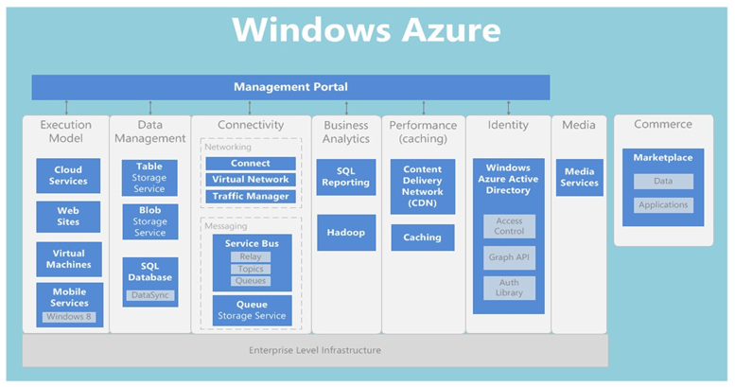
Microsoft Reference Architecture

Slide 12
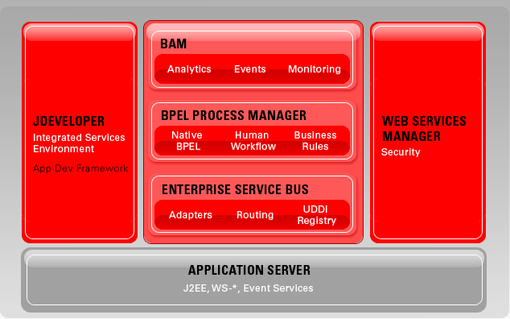
Oracle Reference Architecture

Slide 13
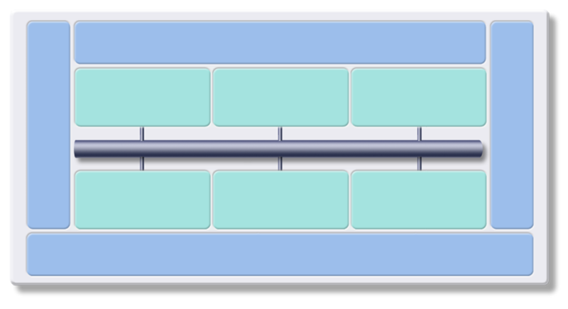
IBM Reference Architecture
Business Innovation & Optimization Services
Facilitates better decision-making with real-time business information
Interaction Services
Process Services
Information Services
Development Services
IT Service Management
Enables collaboration between people, process & information
Orchestrate and automate business processes
Manages diverse data and content in a unified manner
Facilitates communication between services
ESB
Integrated environment for design and creation of solution assets
Monitor, manage and secure services, applications & resources
Partner Services
Business App Services
Access Services
Connect with trading partners
Apps &
Info Assets
Build on a robust, scalable, and secure services environment
Facilitates interactions with existing information and application assets
Infrastructure Services
Optimizes throughput, availability and performance

Slide 14

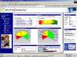

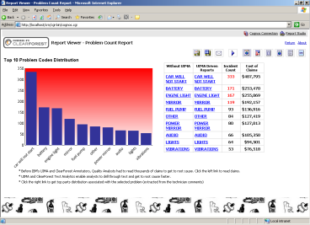



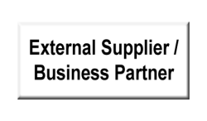
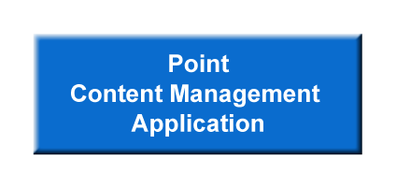
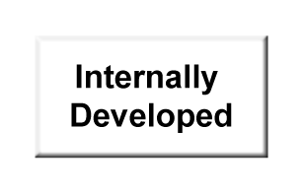


Enterprise Service Bus (ESB)
Tools & Applications
Customer 360
Real-time Transactions
Analytics
Operational
Control
Of
Data Flows
Course / Fine
Grained
Services
Business
Process
ESB
Virtualization Of Business Process
Heterogeneous Applications & Information
Notes:
One of the imporant “styles” of integration we address with SOA is Data Intedration, which often amounts to virtualization of the data This virtualization shows up in two ways:
- Publication of data as a service.
- Consumption of the data via a service. By virtualizing the data, we can create custom views of the data to make it more meaningful. Thus the user (requestor) of this data will retrieve the data based on a logical view, rather than the physical layout of the data – which may actually exist in several data sources. The user doesn’t have to know where the data actually exists, or in what form. Consider a logical record of a customer that may be made up of pieces of data from several sources, including basic cust data, active orders, order history, factory or warehouse locations, etc. As new requirements emerge, new data views can be created, and the data consumed via a service request. (much easier programming model)

Slide 15
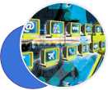
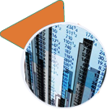
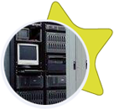




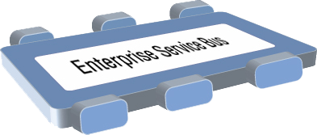










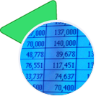
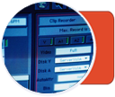

Enterprise Service Bus (ESB)
ROUTING messages between services
CONVERTING transport protocols between requestor and service
TRANSFORMING message format between requestor and service
HANDLING business events from disparate sources
Notes:
Slide Objective:
To define ESB and talk about various functionalities.
Details
An enterprise service bus gives you the flexible connectivity infrastructure you need for integrating applications and services to power your SOA
It handles ROUTING of messages between services
CONVERTING transport protocols between requestor and service
TRANSFORMING message format between requestor and service
HANDLING business events from disparate sources

Slide 16


Enterprise Service Bus (ESB)
Sys A
Addr
Out
Enterprise Service Bus
In
Enterprise
Address
Service
Sys B
3rd Party Address Services

Slide 17
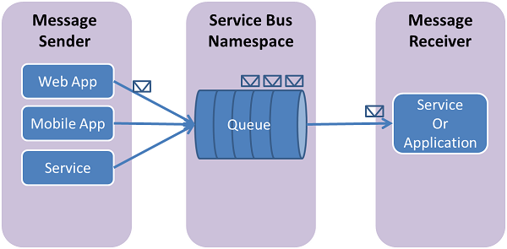
Messaging

Slide 18
Web API vs. Web Service
The Outerlimits
3rd Party
Web Services
3rd Party
Web API
REST / SOAP
REST / JSON
REST / JSON
Web API
FrontOffice Fabric
REST / JSON
SOAP / XML
Enterprise Service Bus
Your Company
SOAP / HTTP / JMS
BackOffice Fabric

Slide 19
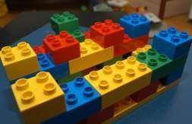
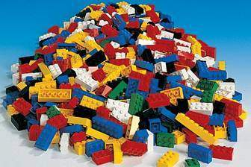
SOA Governance
Without proper management and governance of your SOA…
This could become…
… like this
The promise of SOA
A pile of services
… and so would go the promised benefits of SOA
Notes:
You need to get control of your service environment or you will fail…

Slide 20
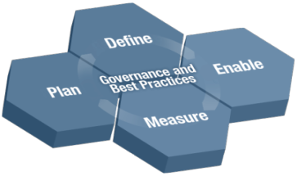
SOA Governance
Establish the Governance Need
Document and validate business strategy for SOA and IT
Assess current IT and SOA capabilities
Define/Refine SOA vision and strategy
Review current Governance capabilities and arrangements
Layout governance plan
Define the Governance Approach
Define/modify governance processes
Design policies and enforcement mechanisms
Identify success factors, metrics
Identify owners and funding model
Charter/refine SOA Center of Excellence
Design governance IT infrastructure
Monitor and Manage the Governance Processes
Monitor compliance with policies
Monitor compliance with governance arrangements
Monitor IT effectiveness metrics
Deploy the Governance Model Incrementally
Deploy governance mechanisms
Deploy governance IT infrastructure
Educate and deploy on expected behaviors and practices
Deploy policies

Slide 21
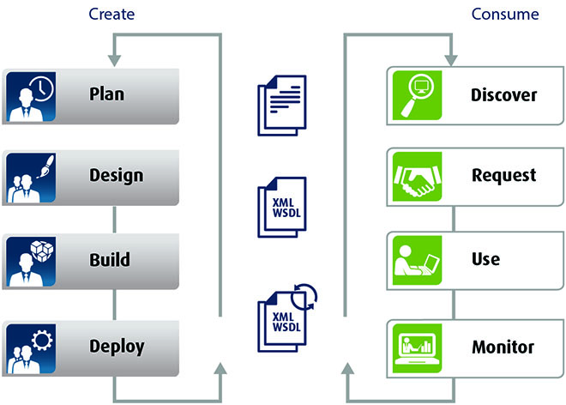
SOA Governance
A Registry/Repository is an enterprise-wide system for Storing, Accessing, and Managing SOA Metadata to provide for service virtualization and management of the service-based environment
Notes:
*Main point: This is the industry view of Service Registry that provides a metamodel enabling a world class central catalog of valid and approved services that an efficient SOA can leverage across the entire deployment.
The registry is used to Find, Publish, Manage and Subscribe to services with the assurance that the underlying policies associated with correct usages of these services are enforced and governed.
FIND
Search/Browse and for services with varying degrees of criteria driven by any metadata associated with the service
PUBLISH
Add new services through an approval process to be available and managed in an enterprise-wide scale
SUBSCRIBE
Register to listen to any changes to the metadata associated with the services
MANAGE
Provide customizable processes to manage the lifecycle
of services in the registry enabling access control, promote / retire and analyze changes to services through impact analysis
Customers have the capability of the service repository storing basic SOA entities such as WSDL and interaction using UDDI today in what could be viewed as first generation registry. Increasingly, the SOA deployments will involve generation and management of more varieties of entities such as XML Schemas, BPEL definitions, invocation policy terms, service component definitions, service entity relationships etc. We intend to extend our capability in this area to provide service registry capability within SOA foundation offering. Project “Moped” is our effort to leverage the rich technology assets in this space and build the next generation service registry to support a wide range of requirements including the ability to publish, find, subscribe to, execute, manage, and administer services, with the rich interaction model that our customers will benefit from. An early technology preview will be available in Q1 2006. We are publishing details, including technical white papers and the broader interaction models in this space.

Slide 22
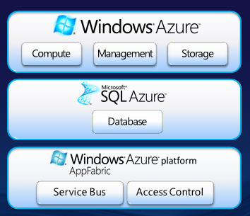

Microsoft – Azure
http://azure.microsoft.com/en-us/

Slide 23
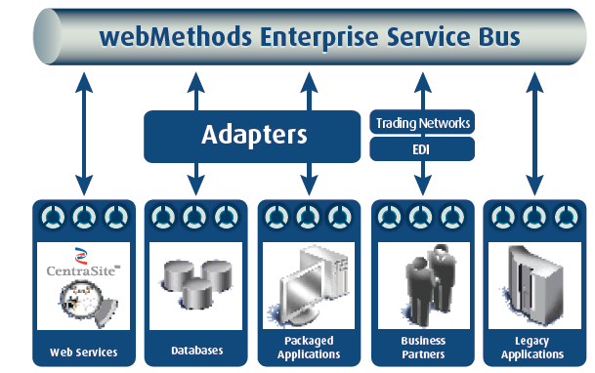

Software AG - WebMethods
http://www.softwareag.com/

Slide 24
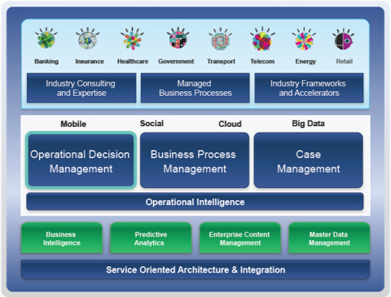

IBM - WebSphere
http://www.ibm.com

Slide 25
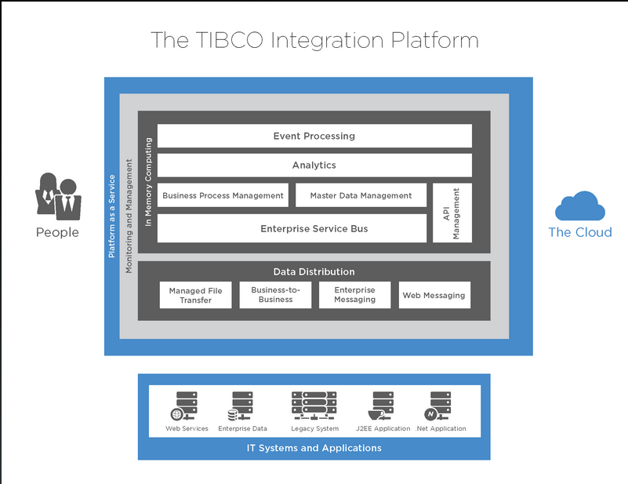

TIBCO - Integration
http://www.tibco.com/

Slide 26
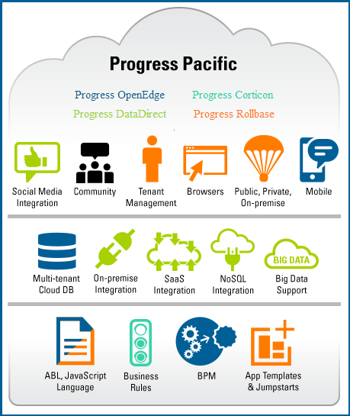

Progress - Pacific
http://www.progress.com/

Slide 27
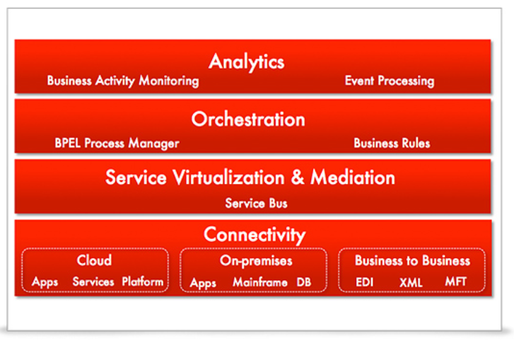
Oracle - SOA Suite
http://oracle.com/

Slide 28
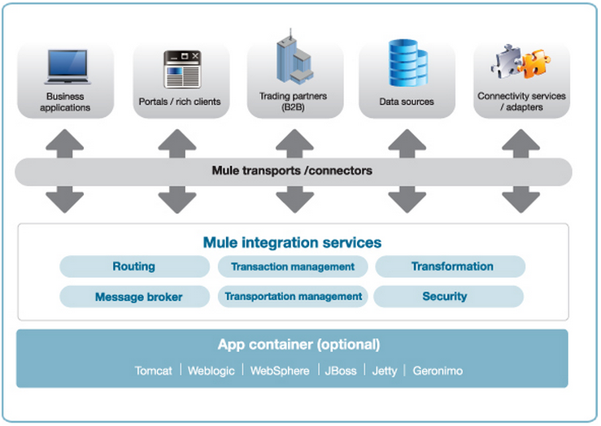

MuleSoft – Mule ESB
https://www.mulesoft.com/

Slide 29
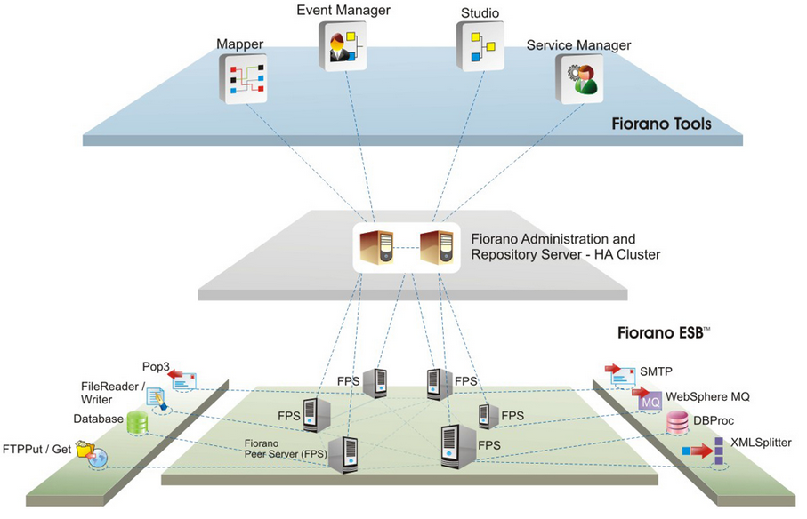

Fiorano - Integration
http://www.fiorano.com/

Slide 30

Jay Ashbaugh
Software Development Manager
Valorem Consulting | 2101 Broadway, Suite 31 | Kansas City, MO 64108
855.864.9929 Office
816.738.0335 Mobile
Jay.Ashbaugh@valoremconsulting.com | valoremconsulting.com
LinkedIn: www.linkedin.com/in/jayashbaugh
Tweeter: @TEAMAshbaugh

Slide 31
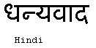




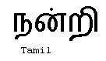


Obrigado
Gracias
Thank You
Danke
Grazie
Merci

